Slide 1
High performance public sector analytics teams
Peter Ellis
Manager Sector Trends, October 2016

Slide 2
Today’s talk
Team role
Approach and capability
Capability building reflections
Case studies
Tourism forecasts
Modelled Territorial Authority GDP case study

Slide 3
Evidence Monitoring and Governance
Michael Bird
General Manager
Sector Trends
Research and Evaluation
Monitoring and Governance
Labour Market Trends
Research and Evaluation
Energy and Building Trends

Slide 4
‘Trends’ teams roles
Official statistics production
Tourism, energy, employment, housing
Forecasting and modelling
Synthesis, analysis and dissemination
Support policy teams with analysis and data
Manage funding and relations with Statistics New Zealand relating to data production:
Regional Gross Domestic Product
Business Operations Survey
Research and Development Survey
International Travel and Migration
Tourism Satellite Account
Accommodation Survey

Slide 5
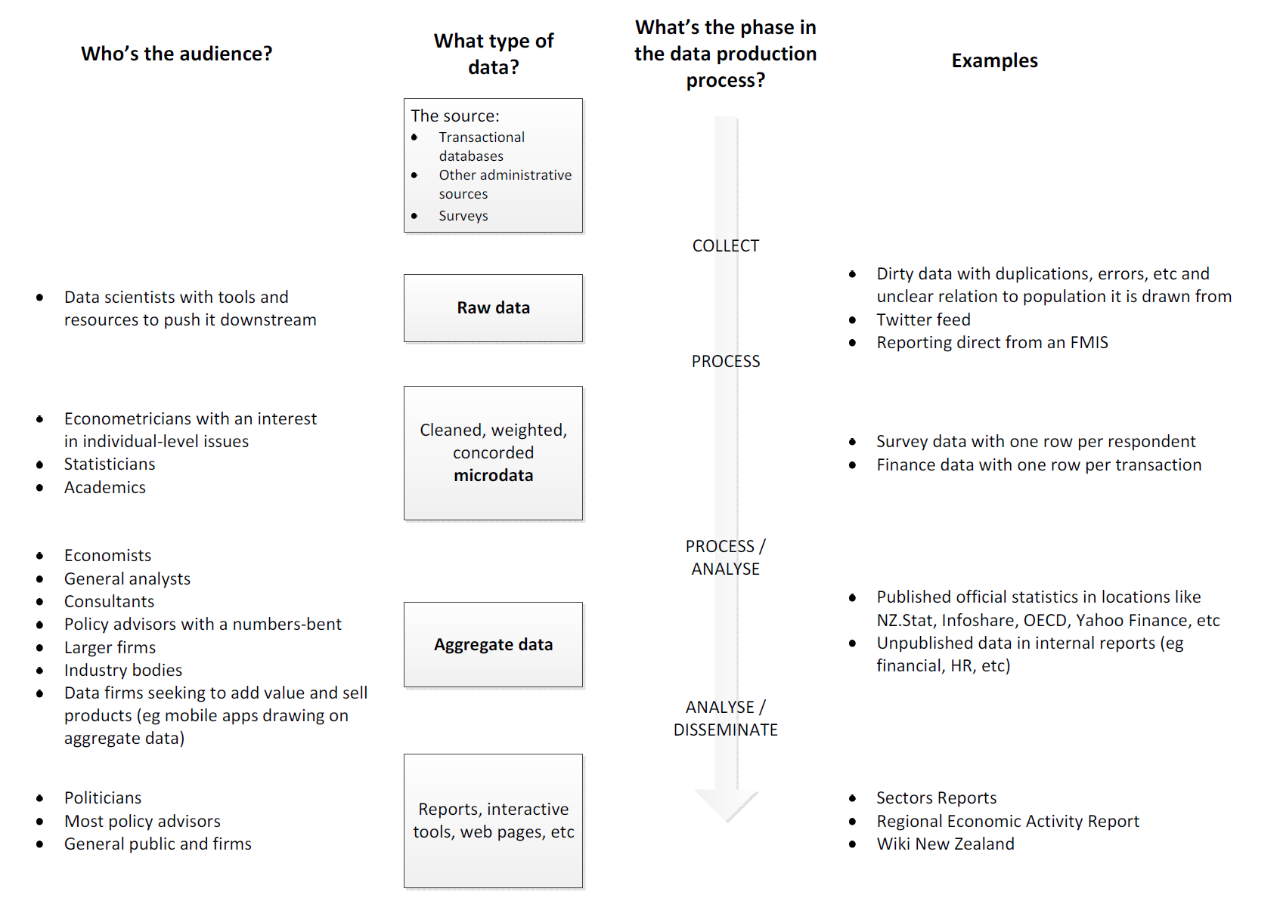

Slide 6
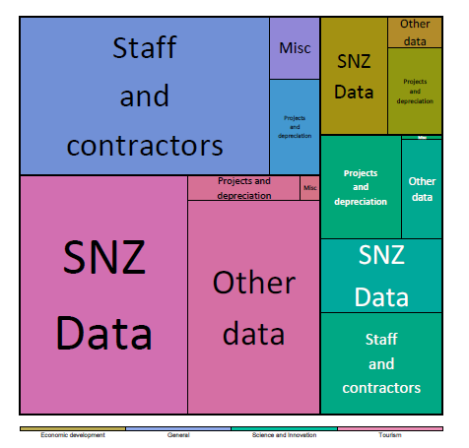
An example analytical team - Sector Trends
$ 5 million per year
17 bodies
Manager, staff, contractors
Backgrounds in a range of quant fields
applied statistics, psychology, computer science, ecology, genetics, computational biochemistry, …

Slide 7
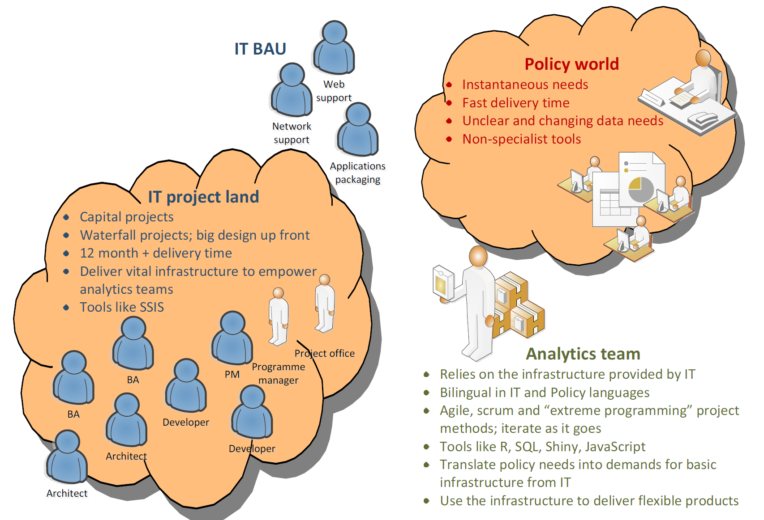

Slide 8
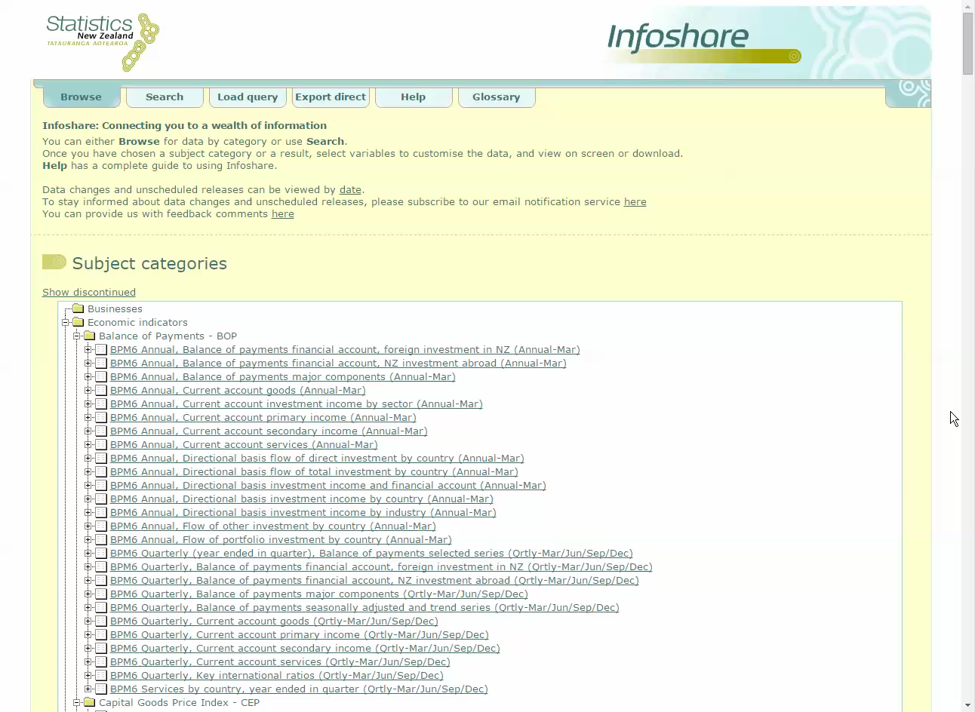

Slide 9
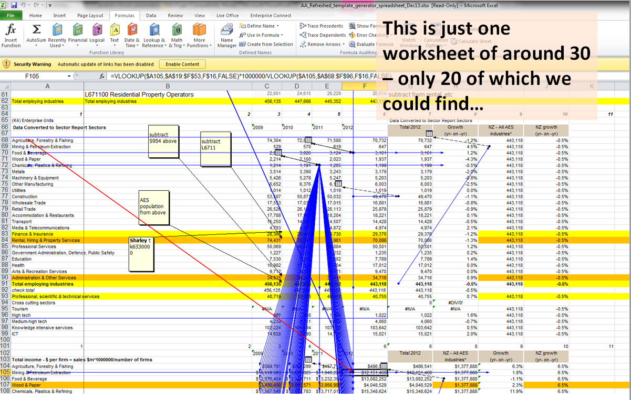
Don’t let it become this….

Slide 10
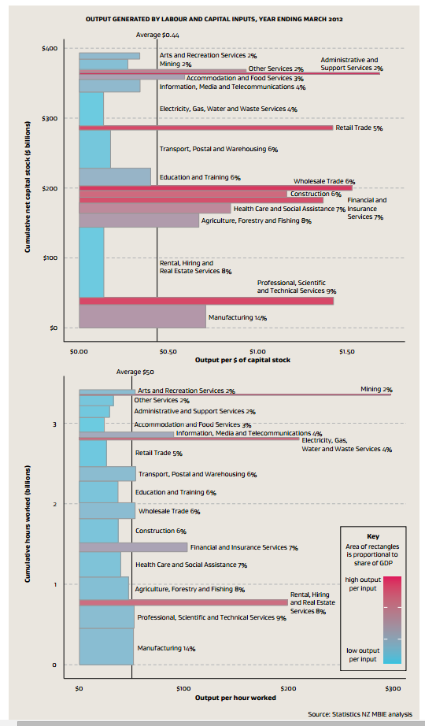
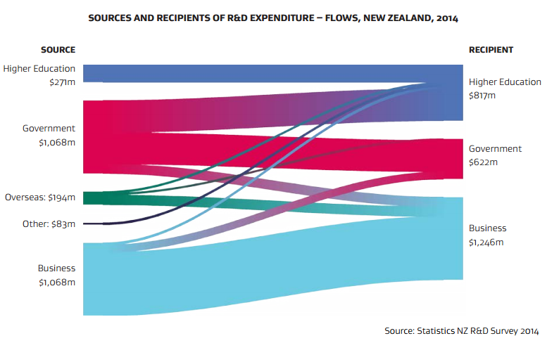
How to turn it into this?

Slide 11
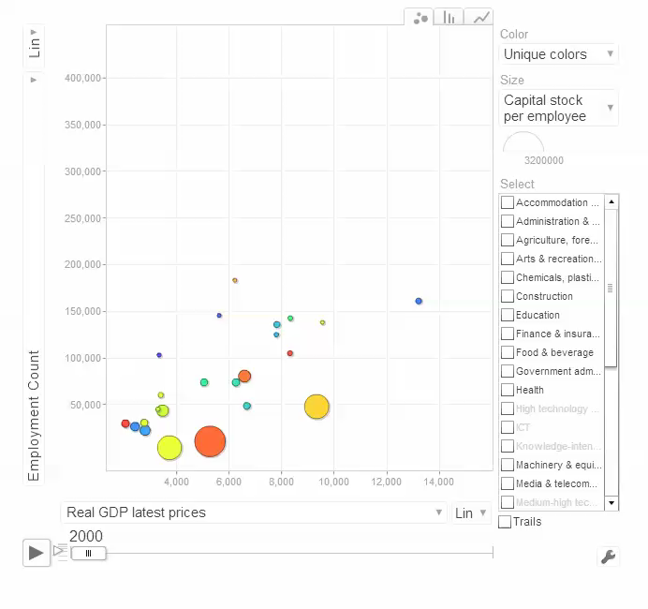
And this?

Slide 12
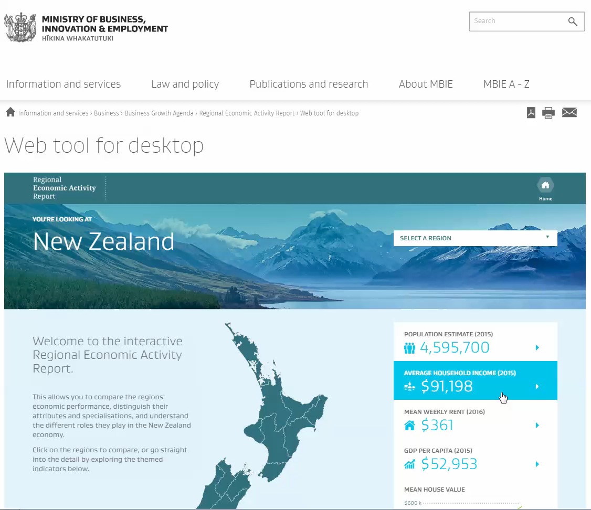

Slide 13


Slide 14
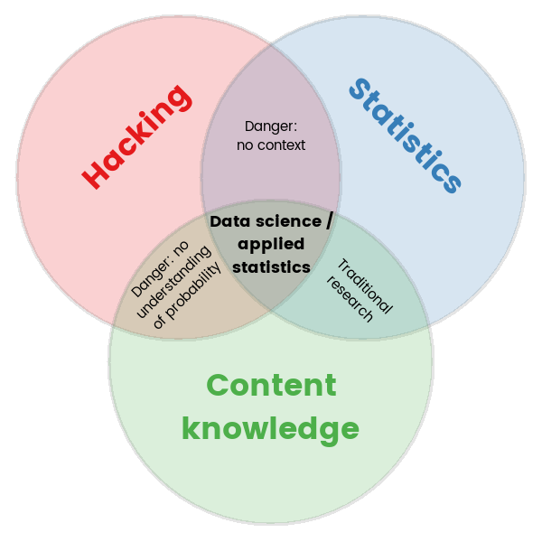
Adapted from http://drewconway.com/zia/2013/3/26/the-data-science-venn-diagram

Slide 15
Approach and tool chain
Everything in code
Everything reproducible
Best-in-breed rather than end-to-end IT solutions
Flexible and medium term rather than permanent solutions
Approaches borrowed from software development
Version-controlled
Modular code
Constant peer review / programming in paris
Frequent integration

Slide 16
The skillset 1 – statistical modelling and inference
Visualisation, visualisation, visualisation…
Timeseries
SARIMA, VAR, forecasting, breakpoints…
Complex surveys
stratification, raking, delete-n-jackknifing, survey-based inference
General modelling
GLMs, GAMs, lasso…
Other stuff
Neural networks, classification, machine learning, classification, multidimensional scaling, text mining, 2SLS and SEM
Meta-methods
Bootstrap, jackknife, cross-validation, multiple imputation, up to date model building strategy

Slide 17
The skillset 2 – the 90% that’s not statistics
Tools
Data management
No Excel for data persistence; all data transformations by code
Data grabbing, cleaning reshaping
People think in terms of “tidy” data, live and breathe SQL, screen-scrape new data in an instant
Workflow
Source version control
Peer review
Testing
Modular scripts
Issues management

Slide 18
Keys to success
Management commitment
Workplace specific environment, data, problems
Use staff rather than external trainers when possible
Atmosphere of continuous learning and imporvement
Well defined, relatively short modules

Slide 19
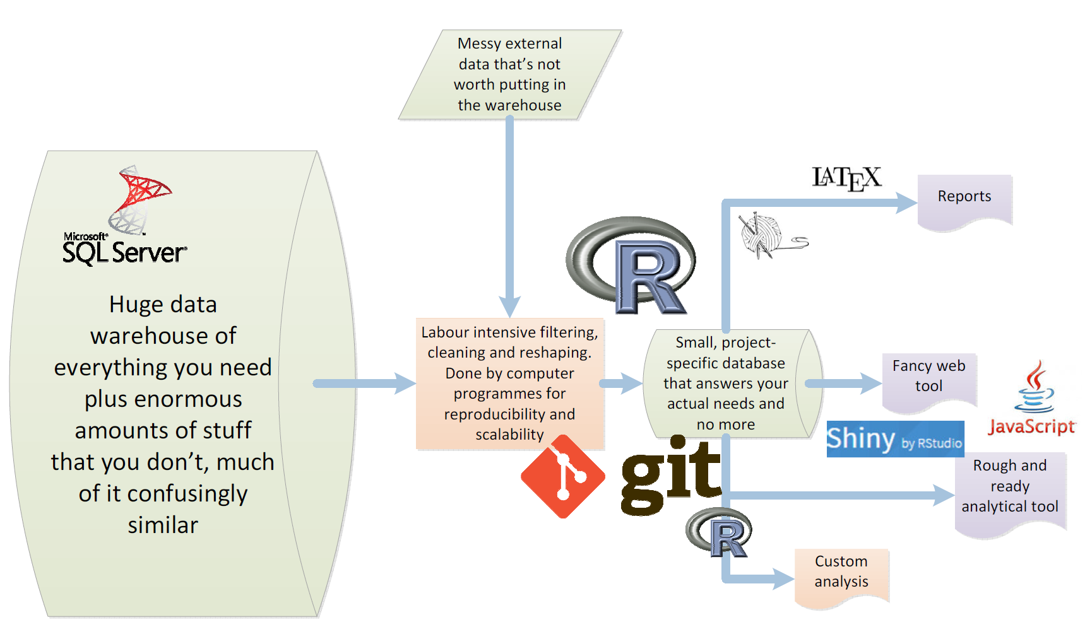

Slide 20
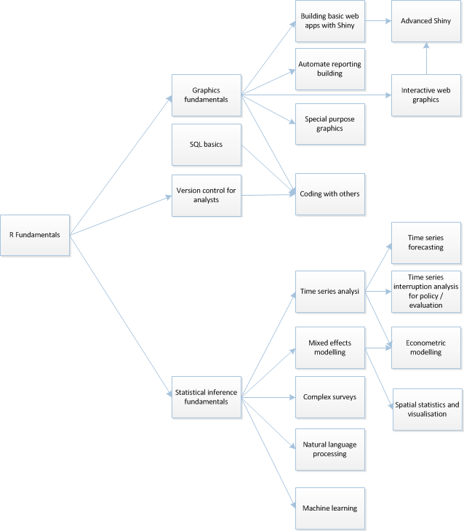
EMG quantitative training path

Slide 21
Story 1 - forecasts
Econometric forecasts combined with expert judgement
Many re-runs of the data
time pressure
version control challenges
many in-text numbers to update
Five people working on report simultaneously
Interactive web-app
Range of custom graphics needed
Solution was the workflow:
database – R – knitr – LaTeX – Shiny

Slide 22


Slide 23
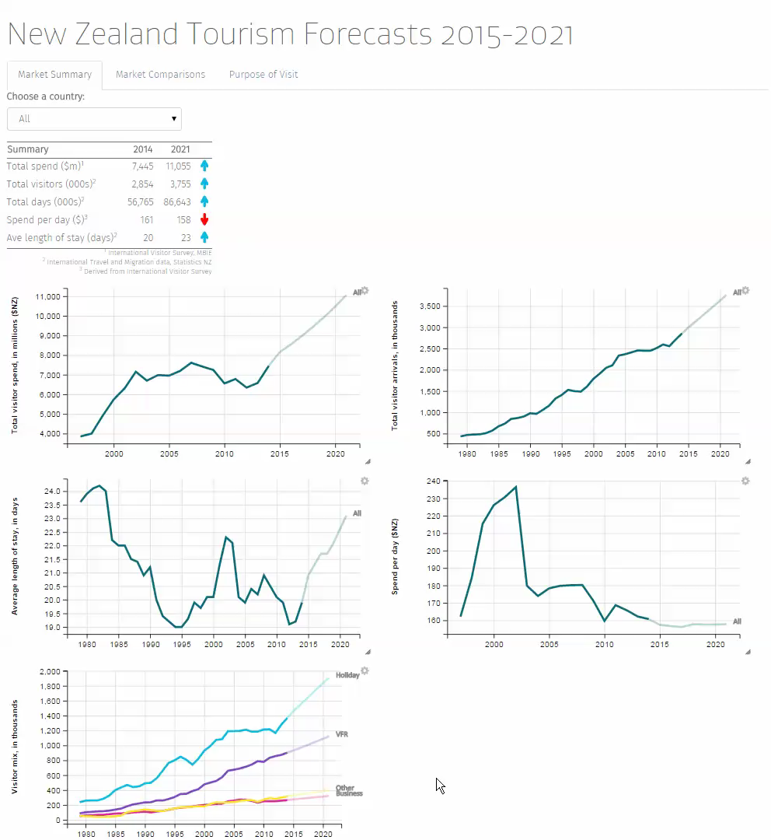

Slide 24
Story 2 – modelled Territorial Authority GDP
Bring together multiple datasets in complex concordance
Small-area estimation methods
Meet strong policy demand for district/city level economic measure that is consistent with published national and regional GDP
Draw on granular employment data to allocate GDP by industry and small areas

Slide 25
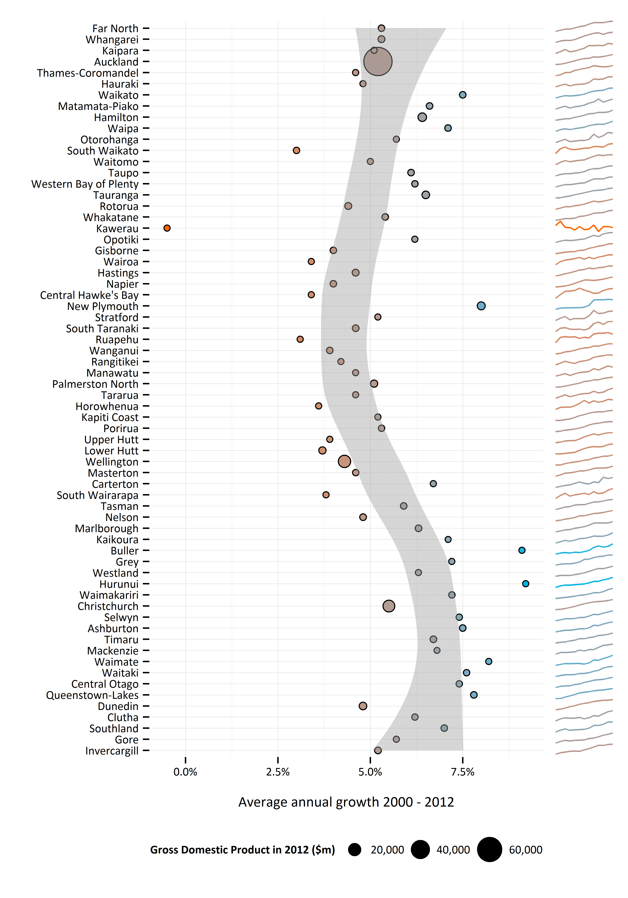
Modelled Territorial Authority GDP
Made possible by Statistics New Zealand publishing detailed data as well as high level.
Open source method and code by MBIE.
Open source / Creative Commons published results

Slide 26
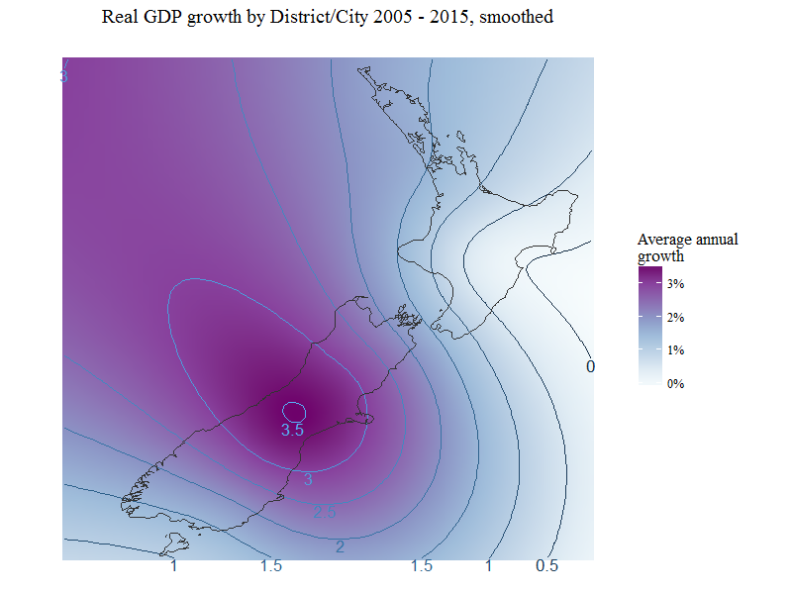

Slide 27
Methodology overview
Step | Data source | Original Granularity | Variable
Starting point… | Business demography | What we want . TA x detailed industry | Poor (employee numbers)
Scale up to… | LEED | Not quite enough. TA x no industry; Region by high level industry; national by detailed industry | Closer (earnings)
Scale up to… | NGDP | Hopeless. National x medium level industry | Right (GDP)
Scale up to… | RGDP | Too high level. Regional x high level industry | Right (GDP)
 | MTAGDP! | Good | Right

Slide 28
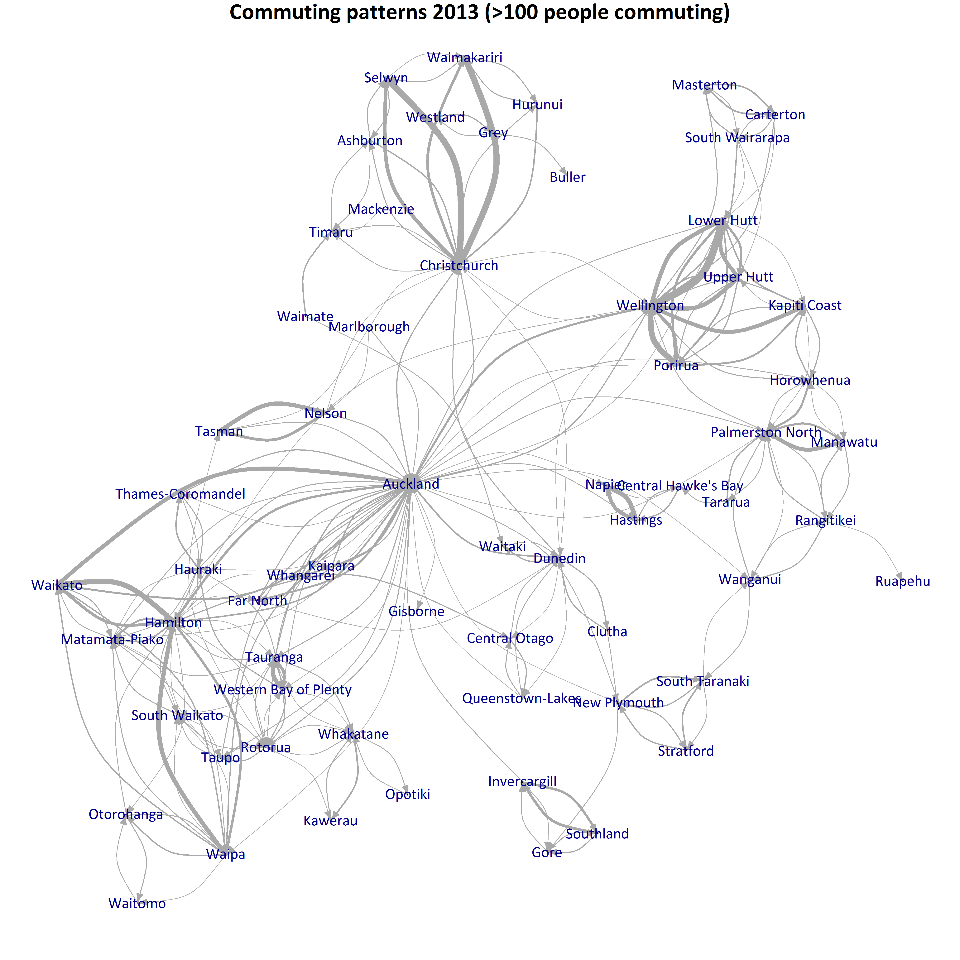
Commuter correction
LEED earnings data is published on basis of residence, not place of work.
We corrected for this by moving a proportion of earnings based on residence-workplace averages in the 2013 census

Slide 29
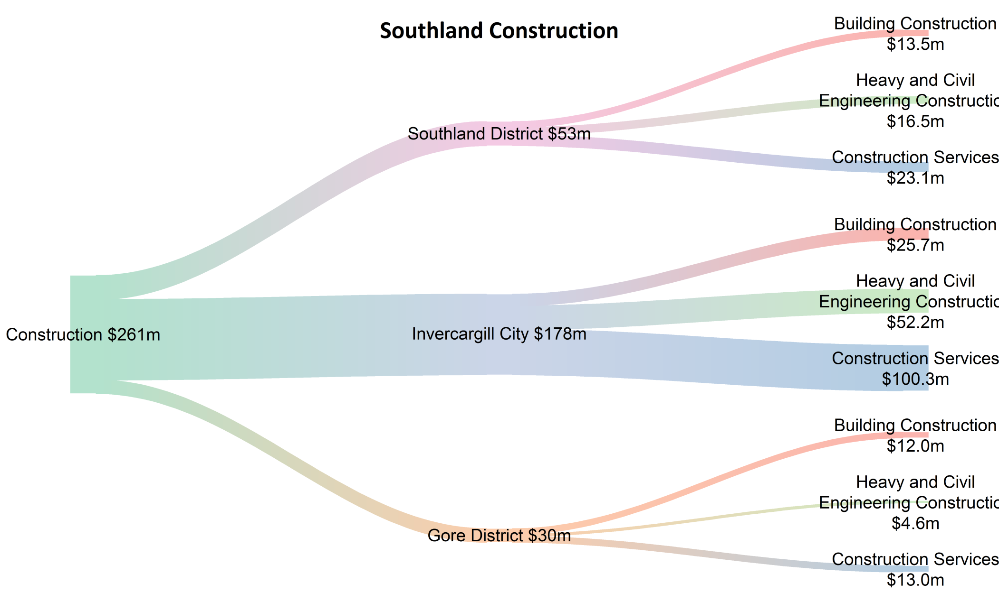
Example results

Slide 30
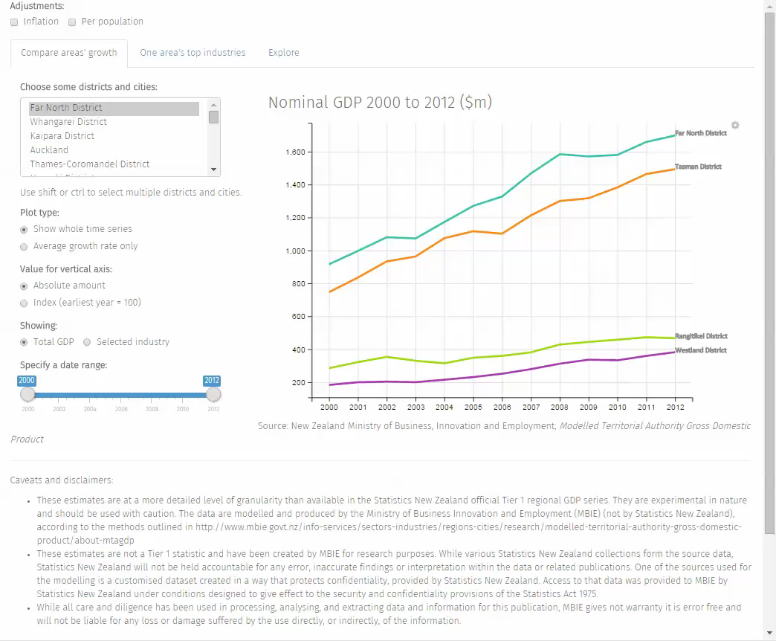

Slide 31
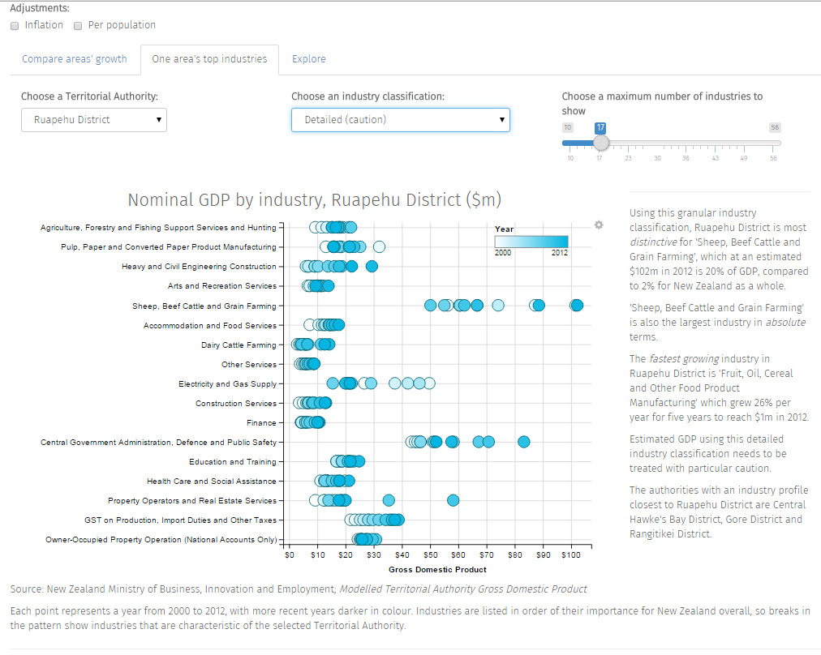

Slide 32
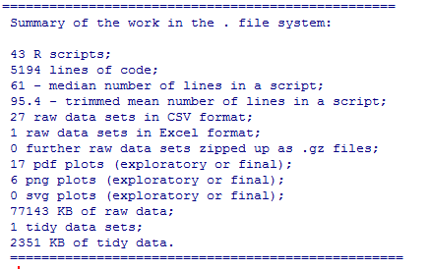
Tools
Git repository of data and R code:

